Slide 1
Chapter 19
Text generation

Slide 2
This chapter …
This chapter emphasizes three main scenarios:
Data-to-Text, in which text is generated to explain or describe a structured record or unstructured perceptual input;
Text-to-Text, which typically involves fusing information from multiple linguistic sources into a single coherent summary;
Dialogue, in which text is generated as part of an interactive conversation with one or more human participants.

Slide 3
Data-to-text generation
Input : Structured records + Unstructured data
Structured records example : Description of a weather forecast
Unstructured perceptual data example : Raw image or video

Slide 4
Data-to-text generation steps
All data-to-text systems share some of the same challenges.
Determining what parts of the data to describe;
Planning a presentation of this information;
Lexicalizing the data into words and phrases;
Organizing words and phrases into well-formed sentences and paragraphs.
The earlier stages of this process are sometimes called content selection and text planning; the later stages are often called surface realization.

Slide 5
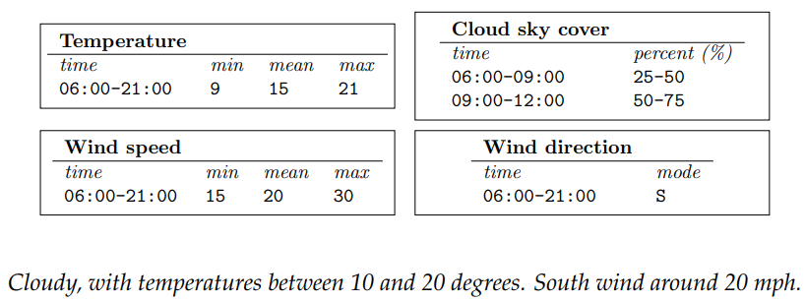
Example:
An example input-output pair for the task of generating text descriptions of weather forecasts
Input
Output

Slide 6

Example
Surface realization can be performed by grammars or templates, which link specific types of data to candidate words and phrases.
Example template for generating descriptions of basketball games
Input
Output
For more complex cases, it may be necessary to apply morphological inflections such as pluralization and tense marking

Slide 7
Data-to-text generation
More recent systems are unified models that are trained end-to-end using backpropagation.
Problem of alignment: labeled examples provide the data and the text, but they do not specify which parts of the text correspond to which parts of the data.
Solution: both latent variables and neural attention have been proposed as solutions

Slide 8







Latent data-to-text
Consider given a dataset of texts and associated records
The goal is to learn a model , so that
is the set of strings over a discrete vocabulary
is a vector of parameters
Relationship between and : the data may contain dozens of records, and may extend to several sentences

Slide 9





Latent data-to-text alignment
Let's decompose the scoring function into subcomponents.
Consider if given an alignment, specifies which element of is expressed in each part of , specifically, let indicates the record aligned to word
Given an observed set of alignments, the score for a generation can be written as sum of local scores

Slide 10



Latent data-to-text alignment
Given an observed set of alignments, the score for a generation can be written as sum of local scores
can represent a bigram language model
can be tuned to reward coherence, such as the use of related records in nearby words.
The parameters of this model could be learned from labeled data:

Slide 11
Latent data-to-text alignment
Problem: The alignments between text and records are usually not available.
Solution: solution is to model the problem probabilistically and treating the alignment as a latent variable.
The model can then be estimated using expectation maximization or sampling

Slide 12
Neural data-to-text generation
The encoder-decoder model and neural attention can be applied to data-to-text generation, with the data acting as the source language in machine translation.
In data-to-text generation, the attention mechanism can link each part of the generated text back to a record in the data.

Slide 13
Data encoders: discrete sets
In some types of structured records, all values are drawn from discrete sets.
In such cases, vector embeddings can be estimated for each field and possible value
The table of such embeddings serves as the encoding of structured record
It is also possible to compress the entire table into a single vector representation, by pooling across the embeddings of each field and value
Example : The birthplace of a person is from a discrete set of locations
Example : One vector embedding for the field BIRTHPLACE,
and another embedding for the value BERKELEY CALIFORNIA

Slide 14
Data encoders : Sequences
Some types of structured records have a natural ordering.
We can resemble this natural ordering as series of events in a game
Each event is a single record, and can be encoded by a concatenation of vector representations for the event type, the event field, and the event values
This encoding can then act as the input layer for a recurrent neural network, yielding a sequence of vector representations
This sequence-based approach can work even in cases where there is no natural ordering over the records

Slide 15
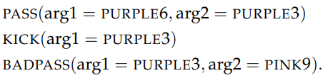

Sequences : robot soccer match Example
The following records describe a sequence of events in a robot soccer match.
Each event is a single record, and can be encoded by a concatenation of vector representations for the event type (PASS), the event field (arg1), and the event values (PURPLE3),
This encoding can then act as the input layer for a RNN

Slide 16
Data encoders : Images
The data-to-text goal for images is the generation of text captions for images
Images are represented as tensors: A color image of 320 × 240 pixels would be stored as a tensor with 320 × 240 × 3 intensity values.
Dominant approach to image classification is to encode images as vectors using a combination of convolution and pooling
Alternative approach is we can apply a set of convolutional networks, yielding vector representations for different parts of the image, which can then be combined using neural attention

Slide 17
Data encoders : Dominant Approach
In dominant , we encode images as vectors using a combination of convolution and pooling
The convolution is applied across the vertical, horizontal, and color dimensions for images.
By pooling the results of successive convolutions, the image is converted to a vector representation
This vector representation, can then be fed into the decoder as the initial state similar to sequence-to-sequence translation mode

Slide 18



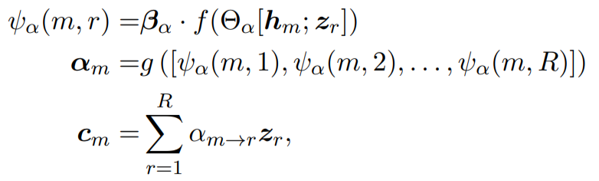







Data encoders : Alternative Approach
Given a set of CNN embeddings of the data , a decoder state , an attention vector over the data can be computed.
When generating word of the output, attention is computed over the records
is an elementwise nonlinearity such as or
is a either SoftMax or elementwise Sigmoid.
The weighted sum gets included in the recurrent update to the decoder state, or
in the emission probabilities
A CNN gets applied to a set of image locations, and the output at each location is represented with a vector . Attention then can then be computed over the image locations.

Slide 19
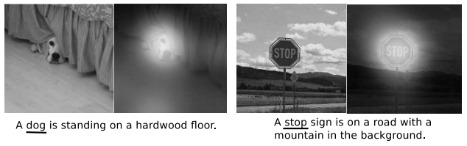
Neural attention in Image captioning
Examples of the image captioning task, with attention masks shown for each of the underlined words
A CNN gets applied to a set of image locations, and the output at each location is represented with a vector . Attention then can then be computed over the image locations.

Slide 20
Decoder
Given the encoding, the decoder can function similar to in neural machine translation
The decoder works using the attention-weighted encoder representation in the decoder recurrence and/or output computation
Problem : Sometimes we need to generate words that do not appear in the training vocabulary;
Solution : Such tokens can be generated in the text by copying them over from the input

Slide 21










Generation and Copy mechanism
Gulcehre et al., 2016
Let’s introduce a variable indicating whether token should be generated or copied. The decoder probability is then:
is indicator function, taking the value 1 if the text of record is identical to the target word
Probability of copying record r from source is ,which is the product
of copy probability by local attention.
The attention weights are computed from the previous decoder state
The computation graph therefore remains a feedforward network, with recurrent paths such as

Slide 22






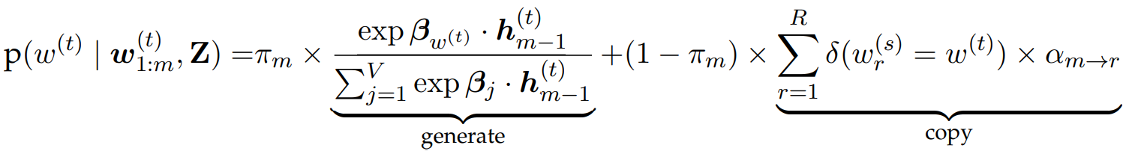
Gen-Copy mechanism Alteration
For end-to-end training, we switch the variable with a gate
This gate gets computed from a two-layer feedforward network, whose input consists of the concatenation of the decoder state
The attention-weighted representation of the data
The full generative probability at token is then

Slide 23
Text-to-text generation
Text-to-text generation includes problems of summarization and simplification.
These problems can be approached in two ways:
1. Through encoder-decoder architecture
2. By operating directly on the input text.

Slide 24
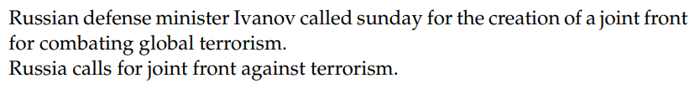
Text-to-text generation : summarization
Sentence summarization is the task of shortening a sentence while preserving its meaning
Sentence summarization is closely related to sentence compression, in which the summary is produced by deleting words or phrases from the original
Also, a sentence summary can also introduce new words.

Slide 25
Neural abstractive summarization
Sentence summarization can be treated as a machine translation problem, using the attentional encoder-decoder translation model
The longer sentence is encoded into a sequence of vectors, one for each token.
The decoder then computes attention over these vectors when updating its own recurrent state.
As with data-to-text generation, it can be useful to boost the encoder-decoder model with the ability to copy words directly from the source

Slide 26


Long documents, fear of repetition
Problem : When summarizing longer documents, an additional concern is that the summary not be repetitive, therefore, each part of the summary should cover new ground.
Solution : This can be addressed by maintaining a vector of the sum total of all attention values thus far:
This total can be used as an additional input to the computation of the attention weights, which enables the model to learn to prefer parts of the source which have not been attended to yet

Slide 27
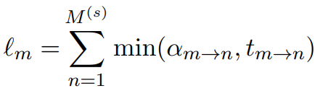


Coverage Loss
To encourage diversity in the generated summary, introduce a coverage loss to the objective function:
This loss will be low if assigns little attention to words that already have large values in
Coverage loss is similar to the concept of marginal relevance, in which the reward for adding new content is proportional to the extent to which it increases the overall amount of information conveyed by the summary

Slide 28
Sentence fusion for multi-document summarization
In multi-document summarization, the goal is to produce a summary that covers all the content of several documents
One approach is to identify sentences across all documents that relate to a single theme, and then to fuse them into a single sentence
Dependency parsing is often used as a technique for sentence fusion.

Slide 29
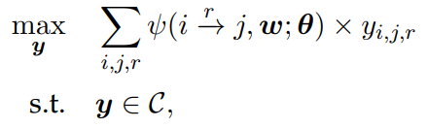
Sentence fusion for multi-document summarization
After parsing each sentence, the resulting dependency trees can be aggregated into a lattice or or a graph structure.
In this graph, identical or closely related words are fused into a single node
The resulting graph can then be pruned back to a tree by solving an integer linear program

Slide 30



the variable indicates whether there is an edge from i to j of type r
the score of this edge is , and C is a set of constraints, which ensures that y forms a valid dependency graph.
As usual, w is the list of words in the graph, and θ is a vector of parameters.
The score reflects the “importance” of the modifier j to the overall meaning.

Slide 31
Sentence fusion for multi-document summarization
Linearization is like the inverse of dependency parsing: instead of parsing from a sequence of tokens into a tree, we must convert the tree back into a sequence of tokens.
This is typically done by generating a set of candidate linearizations, and choosing the one with the highest score under a language model

Slide 32
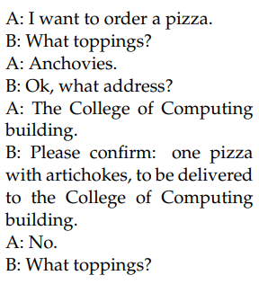
Dialogue
Dialogue systems are capable of conversing with a human interlocutor, often to perform some task , or just to chat
Commercial systems such as Alexa and Siri have recently brought this technology into widespread use
An example of Dialogue can be the following conversation to order pizza.

Slide 33
Finite-state & agenda-based dialogue systems
Finite-state automata is a formal model of computation, in which string inputs and outputs are linked to transitions between a finite number of discrete states.
This model fits simple task-oriented dialogues
Dialogue can be represented with a finite-state transducer

Slide 34
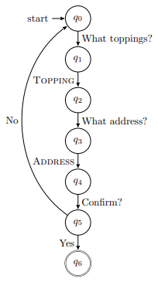
Example of dialogue and the associated finite-state model
The TOPPING and ADDRESS are the two slots associated with the activity of ordering a pizza, which is called a frame.
simple task-oriented dialogue
finite-state transducer

Slide 35

Finite-state & agenda-based dialogue systems
Problem: In case the user wants to communicate more naturally using phrases like I’d, .. How should we approach?
Solution: BIO-style sequence labeling. The tagger can be driven by a bi-directional RNN , similar to recurrent approaches to semantic role labeling
simple task-oriented dialogue
finite-state transducer

Slide 36
Dialogue : Neural chatbots
Chatbots are systems that parry the user’s input with a response that keeps the conversation going
Chatbots can be built from the Encoder-Decoder architecture
Encoder converts the user’s input into a vector
Decoder produces a sequence of words as a response

Slide 37
Dialogue : Neural chatbots
Problem : Encoder-decoder models struggle to maintain coherence over longer conversations.
Solution : Modeling the dialogue context recurrently.
By creating hierarchical recurrent network, including both word-level and turn-level recurrences.
The turn-level hidden state is then used as additional context
in the decoder

Slide 38
Dialogue : Neural chatbots
The encoder-decoder architecture can be integrated into task-oriented dialogue systems.
Neural chatbots can be trained end-to-end:
The user’s turn is analyzed by the encoder
The system output is generated by the decoder.
This architecture can be trained by log-likelihood using backpropagation or by more elaborate objectives, using reinforcement learning

Slide 39
Task-oriented dialogue : MDP and RNN
The Task-oriented dialogue systems, typically involve set of modules: one for recognizing the user input, another for deciding what action to take, and a third for arranging the text of the system output
RNN decoders can be integrated into Markov Decision Process dialogue systems, by conditioning the decoder on a representation of the information that is to be expressed in each turn

Slide 40
Task-oriented dialogue : Element Embedding
Another promising direction is to create embeddings for the elements in the domain:
for example, the slots in a record and the entities that can fill them.
The encoder then encodes not only the words of the user’s input, but the embeddings of the elements that the user mentions.
The decoder is able with the ability to refer to specific elements in the knowledge base.

Slide 41
Thank you very much for listening

